Slide 1
Introduction to Templates
Department of Computer Science,
The University of Lahore, Pakistan

Slide 2
Functions
Main reason for using functions: make pieces of code reusable by encapsulating them within a function.
Example: Interchange the values of two int variables x and y.
Instead of inline code: int temp = x; x = y; y = temp; write a function:
void Swap(int & first, int & second) { int temp = first; first = second; second = temp; }

Slide 3
General Solution
This function gives a general solution to the interchange problem for ints (to exchange the values of any two integer variables):
Swap(x, y);
...
Swap(w, z);
...
Swap(a, b);
NOTE: Inline code would have to be rewritten for each pair of integer variables to swap.

Slide 4
But not for doubles…
To interchange the values of two double variables: Cannot use the preceding function; it swaps ints not doubles.
However, overloading allows us to define multiple versions of the same function:
/* Function to swap two double variables */ void Swap(double & first, double & second) { double temp = first; first = second; second = temp; }
The two different Swap functions are distinguished by the compiler according to each function's signature (name, number, type, and order of parameters).
Signature

Slide 5
And for strings…
To interchange the values of two string variables:
Again, overload function Swap():
/* Function to swap two string variables*/ void Swap(string & first, string & second) { string temp = first; first = second; second = temp; }

Slide 6
What about User Defined Types?
And so on ... for other types of variables.
We would have to overload Swap() for each user-defined type:
/* Function to swap two Time variables */ void Swap(Time & first, Time & second) { Time temp = first; first = second; second = temp; }

Slide 7
Observations:
The logic in each function is exactly the same.
The only difference is in the type of the values being exchanged.
If we could pass the type as an argument, we could write a general solution that could be used to exchange the values of any two variables.

Slide 8
Template Mechanism
Declare a type parameter (type placeholder) and use it in the function instead of a specific type. This requires a different kind of parameter list:
void Swap(________ & first, ________ & second)
{ ________ temp = first; first = second; second = temp; }
template <typename DataType > // type parameter
DataType DataType
DataType

Slide 9
Template Mechanism Comments
The word template is a C++ keyword specifying that what follows is a pattern for a function not a function definition.
Originally, the keyword class was used instead of typename in a type-parameter list.

Slide 10
How is a Template Used?
<typename DataType> names DataType as a type parameter — value will be determined by the compiler from the type of the arguments passed when Swap() is called.
Example: #include "Time.h" #include "Swap.h" //ONE function template definition int main() { int i1, i2; double d1, d2; string s1, s2; Time t1, t2;
... // Compiler generates definitions
// of Swap() with DataType replaced
Swap(i1, i2); // by int
Swap(d1, d2); // by double
Swap(s1, s2); // by string
Swap(t1, t2); // by Time }

Slide 11
General Form of Template
template <typename TypeParam> FunctionDefinition
or
template <class TypeParam> FunctionDefinition
where:
TypeParam is a type-parameter (placeholder) naming
the "generic" type of value(s) on which the function operates
FunctionDefinition is the definition of the function, using type TypeParam.

Slide 12
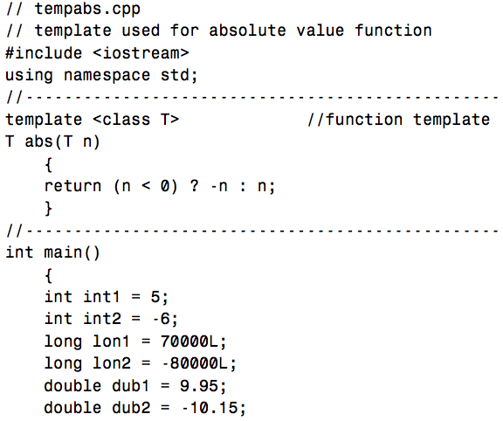
Another Example

Slide 13
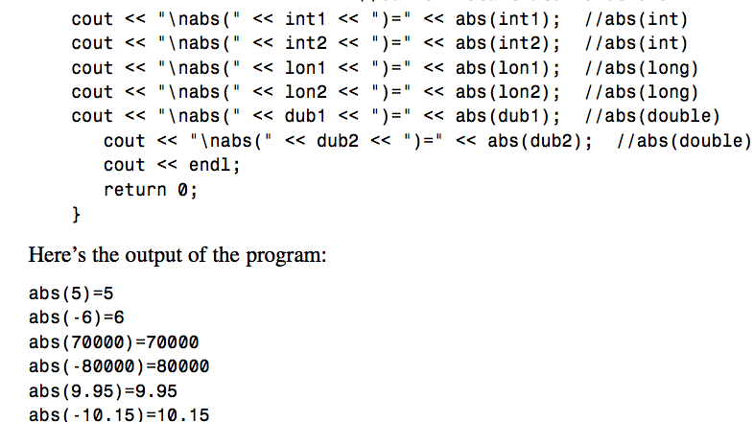

Slide 14
Template Instantiation
A function template is only a pattern that describes how individual functions can be built from given actual types.
This process of constructing a function is called instantiation.
We instantiated Swap() four times — with types int, double, string, and Time.
In each instantiation, the type parameter is said to be bound to the actual type passed.
A template thus serves as a pattern for the definition of an unlimited number of instances.

Slide 15
Class Templates
The template concept can be extended to classes.

Slide 16
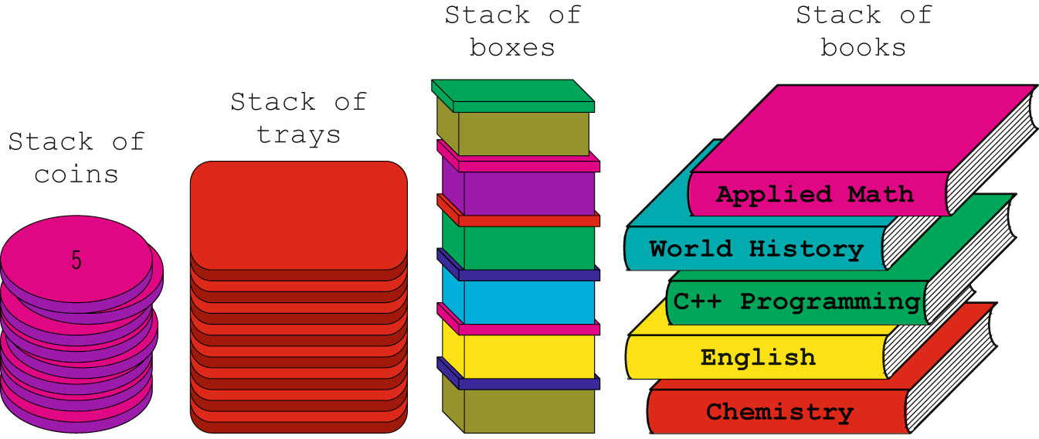
Examples - Stack
Stack: a LIFO (last in, first out) data structure
insertions and deletions take place at one end called Top
Examples:

Slide 17
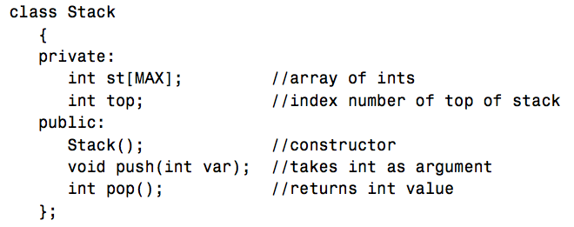
Integer Stack …

Slide 18
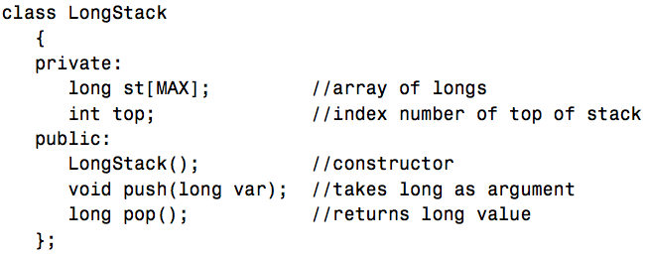
Long Stack …

Slide 19
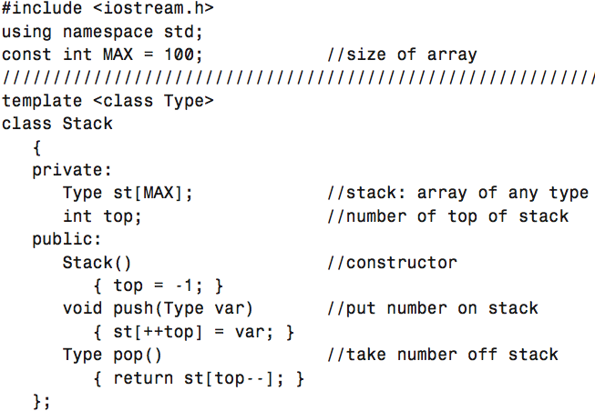

Slide 20
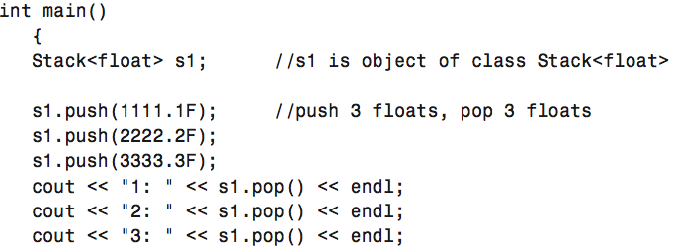
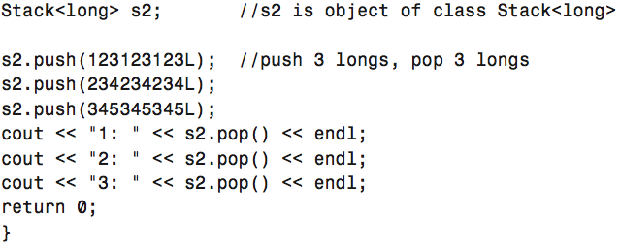

Slide 21
If the member functions are defined externally (outside of the class specification), we need a new syntax.
The expression template<class Type> must precede not only the class definition, but each externally defined member function as well.

Slide 22
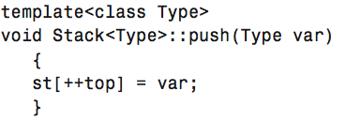

Slide 23
General form of class template declaration
template <typename TypeParam > or template <class TypeParam> class SomeClass { // ... members of SomeClass ... };
More than one type parameter may be specified: template <typename TypeParam₁,..., typename TypeParam_{n}> class SomeClass { // ... members of SomeClass ... };
Can also be set to a default value

Slide 24
Instantiating class templates
To use a class template in a program/function/library: Instantiate it by using a declaration of the form ClassName<Type> object; to pass Type as an argument to the class template definition.
Examples:
Stack<int> intSt;
Stack<string> stringSt;
Compiler will generate two distinct definitions of Stack — two instances — one for intst and one for stringst.

Slide 25


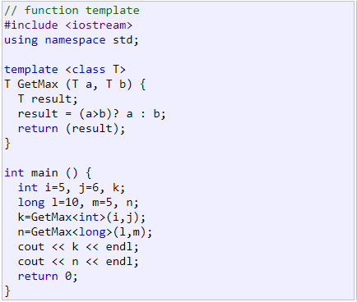

Slide 26

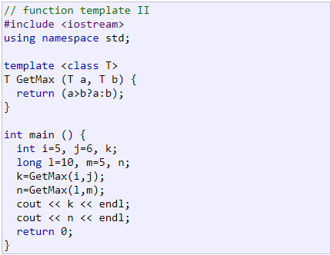

Slide 27
